Slide 1

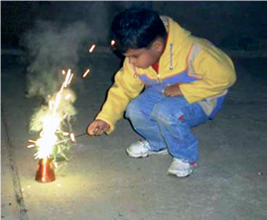
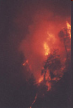

BURNS
Burns
Prof Ranil Fernando
Dept of Surgery

Slide 2
BURNS
Burns
Definition
A burn is injury to tissues caused by
Heat
Chemicals
Electricity
Radiation
Friction

Slide 3
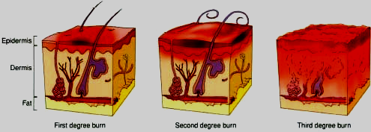
BURNS
Burns
Degree of Burns
First-degree burns damage only the epidermis
Second-degree burns involve the superficial (papillary)
dermis and may also involve the deep (reticular) dermis
layer
Third-degree burns damage all the layers of the skin

Slide 4
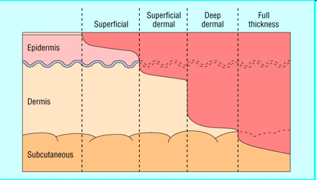
BURNS
Burns
Other Classification

Slide 5
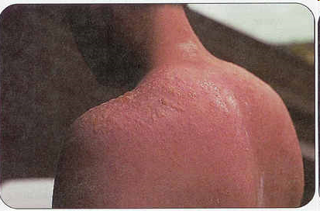
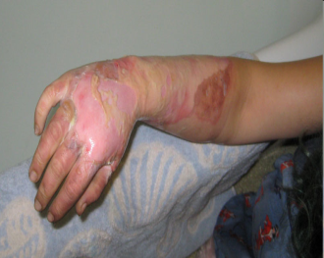
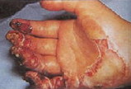
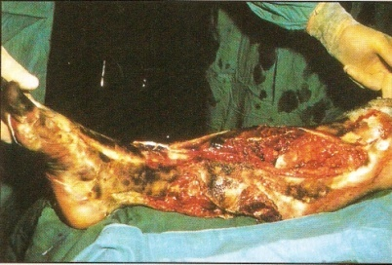
BURNS
Burns
Clinical Features of Burns
First-degree burns - Erythematous and Painful
Second-degree burns
Superficial second-degree (or partial-thickness) burns involve the upper layers of the dermis and are characterized by clear blisters and weeping . They are painful and sensitive to touch and blanch with pressure
Deep second-degree burns involve the deeper layers of the dermis
characterized by hemorrhagic blisters and are covered with a layer
of white or red injured dermis that does not blanch
Third-degree burns
Charring and extreme damage of the dermis and sometimes
loss of hair shafts and keratin hard eschar will be present
Fourth-degree burns damage muscle, tendon,
and ligament tissue, thus result in charring and
catastrophic damage of the hypodermis. They develop
compartment syndrome which threatens both the
life and the limb and the patient

Slide 6
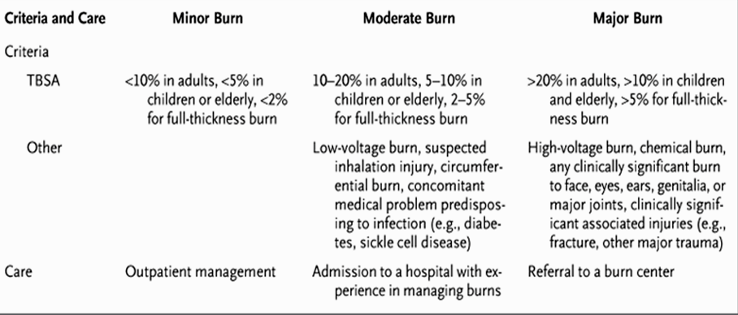
BURNS
Burns
Classification of Severity

Slide 7

BURNS
Burns
Thermal (heat) burns
Commonest cause of Burns
The amount of tissue damage depends on the duration of
contact, the skin thickness in the area of exposure
Not all thermal burns are caused by flames
Contact with hot objects, flammable vapor that ignites and
causes a flash or an explosion
Steam or hot liquid are other common causes of burns
Scald - burn with moist heat

Slide 8
BURNS
Burns
Introduction
Burns are responsible for significant mortality and
morbidity worldwide
One of the most devastating of all injuries
Outcomes span the spectrum from physical
impairments and disabilities to emotional and mental
consequences
Over 90% of fatal fire-related burns occur in
developing or LMICs with South-East Asia,
accounting for over half of the fire-related deaths

Slide 9
BURNS
Burns
Chemical Burns
A wide range of chemical agents can cause tissue damage
and death if they come in contact with the skin.
As with thermal burns, the amount of tissue damage depends
on the duration of contact, the skin thickness in the area of
exposure, and the strength of the chemical agent
Chemicals will continue to cause tissue destruction
until the chemical agent is removed
Three types of chemicals-acids, alkalis, and organic
compounds - are responsible for most chemical burns.

Slide 10
BURNS
Burns
Electrical burns
The severity of an injury from contact with electrical current
depends on the type of current (direct or alternating), the
voltage, the area of the body exposed, and the duration
of contact
Type of Circuit
Direct current (DC)
– Muscle spasm
Alternating current (AC)
- 3 times more dangerous
- Muscle contraction (tetany)

Slide 11
BURNS
Burns
Inhalation Injuries
Breathing in hot air or gases can cause injury to lungs
The Injuries are
Damage from Heat Inhalation:
  True lung burn occurs only if you directly breathe
  in a hot air/flame source, or have high pressure force the heat
  In most cases, thermal injury is confined to the upper airways
Damage from Systemic Toxins:
  Breathing in toxic gases, such as Carbon Monoxide, can cause
  poisoning
Damage from Smoke Inhalation:
  Smoke intoxication is frequently hidden by more visible injuries
  such as burns as a result of fire

Slide 12
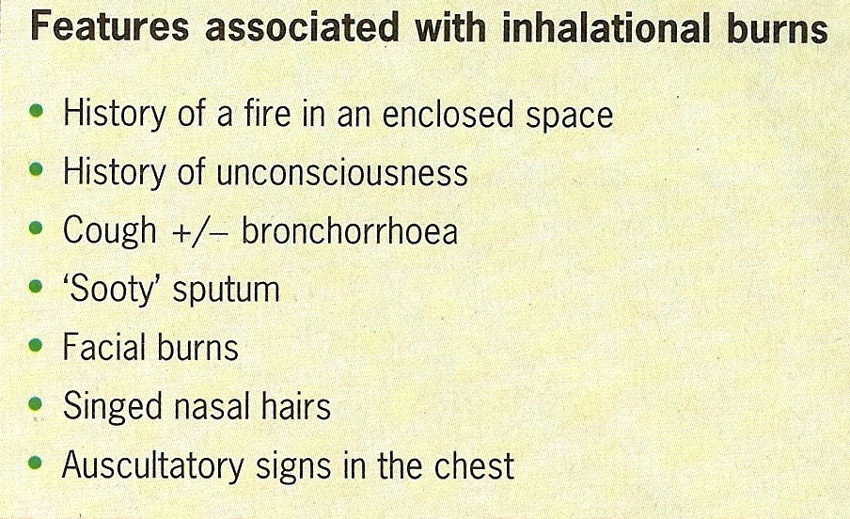
BURNS
Burns

Slide 13
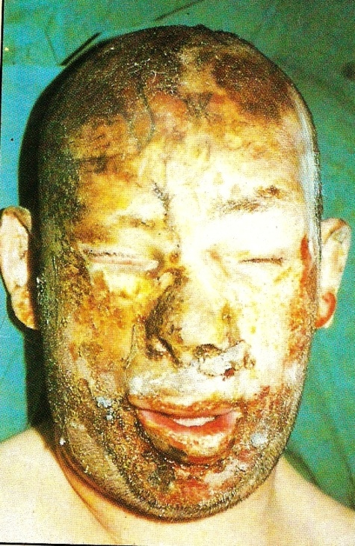
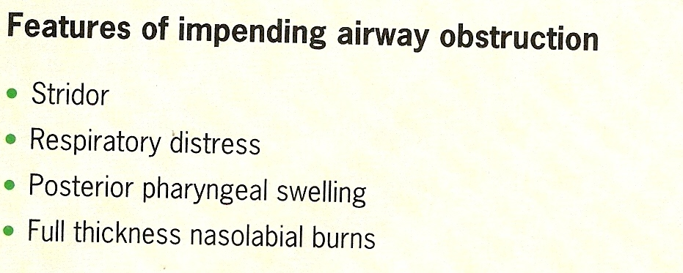
BURNS
Burns
Assessment of Patient with Burns
Initial Assessment
History - Time of Burn , Type of Burn, Circumstances,
Co - Morbidity
Examination - A B C , Injuries & Weight
Assessment of Burn Surface Area (BSA)

Slide 14
BURNS
Burns
Assessment of TBSA General Rules
It is important that all of the burn is exposed and
assessed
During assessment, the environment should be kept
warm, and small segments of skin exposed
sequentially to reduce heat loss
Pigmented skin can be difficult to assess, and in such
cases it may be necessary to remove all the loose
epidermal layers to calculate burn size

Slide 15
BURNS
Burns
Assessment of Burn
Palmar Surface
-The surface area of a patient's palm (including fingers)
is roughly 0.8%of total body surface area.
Palmar surface area can be used to estimate relatively small burns (< 15% of total surface area) or very large burns
(> 85%, when unburnt skin is counted).
For medium sized burns, it is inaccurate

Slide 16
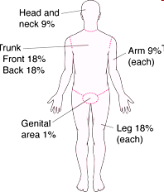
BURNS
Burns
Wallace rule of Nines
This is a good, quick way of estimating medium to large burns in adults.
The body is divided into areas of 9%, and the total burn area can be calculated.
It is not accurate in children

Slide 17
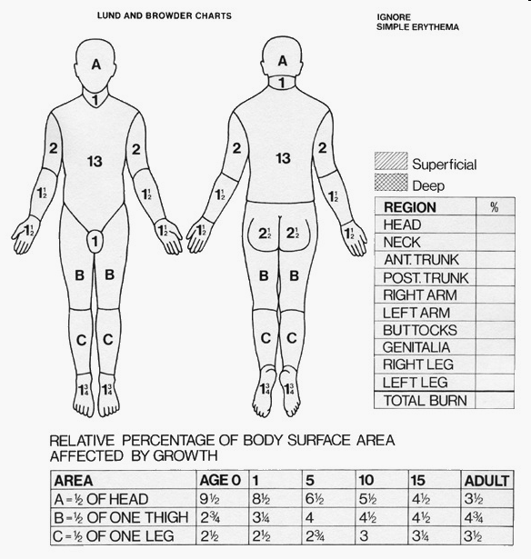
BURNS
Burns
Lund and Browder chart
This chart, if used correctly,
is the most accurate method
It compensates for the
variation in body shape
with age and therefore
can give an accurate
assessment
of burns area in
children

Slide 18
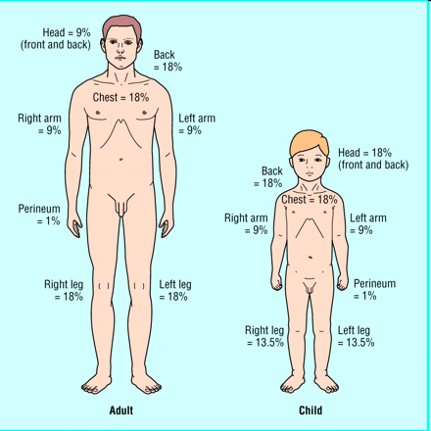
BURNS
Burns
Assessment of Burn Surface Area (BSA)

Slide 19
BURNS
Burns
Pathophysiology of Burns - Fluid Shift
The underlying process involved is both a local and systemic inflammatory reaction
The margination of neutrophils, macrophages, and lymphocytes is associated with the release of a rich milieu of mediators
Normal capillary barrier is disrupted these mediators, including histamine, serotonin, prostaglandins, platelet products, complement components, and members of the kinin family
Due to changes in vascular permeability there is a immediate shift of intravascular fluid into the surrounding interstitial space - Oedema

Slide 20
BURNS
Burns
The Pathophysiology of the burn injury is prolonged and slow to evolve unlike many other forms of trauma
Proteins and fluids pour out into the damaged area and,
protein and fluid losses reflect the area of the injured skin
If the wound is large enough, perhaps more than 30% of the
body surface area, there is an appreciable loss of fluid into
the undamaged tissues
Change in the capillary permeability is maximal at about 8 h
after the injury and returns towards normal over the next 36
hours
Water and electrolytes diffuse back into the circulation
leaving the proteins trapped in the interstitial spaces where
they are eventually removed by the lymphatics

Slide 21
BURNS
Burns
Heat-induced denaturing of collagen fibers in the interstitium, causing a physical expansion of the potential third space with a transient -20 to -30 mm Hg negative-pressure gradient favoring extravasation of fluid - Worsens oedema
In adults with burns of 25-30% TBSA, damage to cell membranes is associated with a decrease in transmembrane potential and the accumulation of intracellular sodium and water, with resultant swelling at the cellular level
The capillary barrier begins to regain its integrity, hence the
reduction in fluid requirements is observed
Resuscitation is associated with a restoration of the transmembrane potential toward normal, but unlike hemorrhagic shock, this deficit is corrected only partially

Slide 22
BURNS
Burns
Pathophysiology of Burns - Histological Changes
Burn wound and surrounding tissues is a system of several circumferential zones radiating from burned tissues
Zone of coagulation - A nonviable area of tissue at the epicenter of the burn
Zone of ischemia or stasis - Surrounding tissues (both deep and peripheral) to the coagulated areas, which are not devitalized initially but, due to microvascular insult, can progress irreversibly to necrosis
Zone of hyperemia - Peripheral tissues that undergo vasodilatory changes due to neighboring inflammatory mediator release but are not injured thermally and remain viable

Slide 23

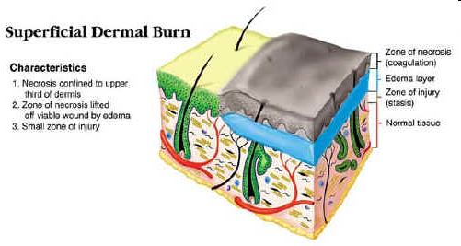
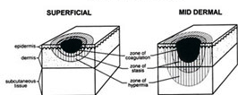
BURNS
Burns
Pathophysiology of Burns - Histological Changes
Jackson's burns zones

Slide 24
BURNS
Burns
The tissues in ischemic areas can potentially be
salvaged by proper resuscitation and by proper burn wound excision and antimicrobial therapy in the convalescent period
Reevaluation of these threatened areas over the first
several days is used to determine when the first burn
excision should be performed
Burn wound progression is complex and caused by additive effects of inadequate tissue perfusion, free radical damage, and systemic alterations in the cytokine milieu leading to protein denaturation and necrosis

Slide 25
BURNS
Burns
Other Pathophysiological Changes
All patients are markedly Hypermetabolic throughout
with loss of lean body mass
The hypermetabolic response, which is mediated by
hugely increased levels of circulating catecholamines,
prostaglandins, glucagon and cortisol, causes
  Profound skeletal muscle catabolism
  Immune deficiency
  Peripheral lipolysis,
  Reduced bone mineralisation
  Reduced linear growth
  Marked increased in energy expenditure

Slide 26
BURNS
Burns
Management
Initial Management
History+ Exn, Intravenous lines , IV Analgesia , Catheter & others
4 Main aspects to further management
  Fluid resuscitation
  Nutritional support
  Burn Wound care
  Rehabilitation

Slide 27
BURNS
Burns
Fluids in Burns
Parkland formula for burns resuscitation
Total fluid requirement in 24 hours =
4 ml x (total burn surface area (%)) x (body weight (kg))
50% given in first 8 hours
50% given in next 16 hours
Children receive maintenance fluid in addition, at hourly rate of
4 ml/kg for first 10 kg of body weight plus
2 ml/kg for second 10 kg of body weight plus
1 ml/kg for > 20 kg of body weight
End point
Urine output of 0.5-1.0 ml/kg/hour in adults
Urine output of 1.0-1.5 ml/kg/hour in children

Slide 28
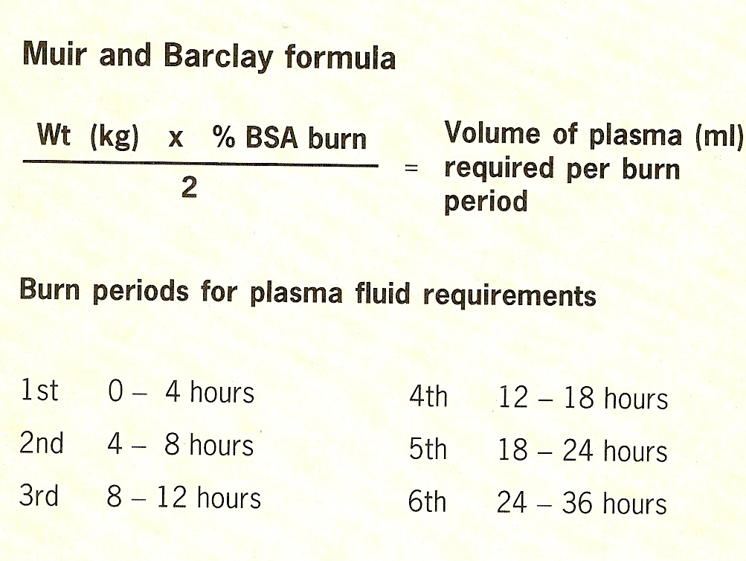
BURNS
Burns
Fluids
What Fluids?
Crystalloids Vs. Colloids
Consensus - Crystalloids
Ringer Lactate Solution
Other Formulae
  Modified Parkland formula
  Brooke formula
  Modified Brooke formula
  Evans formula
  Monafo formula

Slide 29
Burns
Monitoring resuscitation
The following should be monitored:
General state - restlessness suggests hypoxia
Warm peripheries
Pulse under 120 per min
Urinary output adequate (0.5 ml/kg/h) - no more and no less
Daily urea, electrolytes, haemoglobin and haematocrit levels
Blood pressure measurement is often imprecise as limbs have
been burned or become oedematous
CVP is confusing except when there are associated injuries
or where an overload is planned to increase urine flow
Clotting studies and platelet levels are not contributory

Slide 30
BURNS
Burns
Nutrition
Crucial part of Management - Formulae for calculation
are available
Calorie requirement BMR x2
Carbohydrate - 5mg/Kg.min
Protein - 1.5 -2.5gr/Kg/day
Fats to meet the rest of the calories

Slide 31
BURNS
Burns
Burns are dynamic injuries that may progress over the first 2 to 3
days
The primary goal in the management of wounds is to achieve rapid
healing with optimal functional and aesthetic results
A moist environment for the wound accelerates healing by
preventing cellular dehydration and stimulating collagen synthesis
and angiogenesis
A moist environment may be created by covering the wound with a
topical antimicrobial agent or by applying an occlusive dressing
that reduces the loss of fluid through evaporation
Topical Agents - Silversulphadiazine, Mefanemic acid(10%)
Silver Nitrate (0.5%)
Negative Pressure Dressings ?
Burn Wound

Slide 32

Burns
Immobilization times for different types of skin reconstruction
Biological dressings any -preferably not full thickness
(such as Biobrane, TransCyte) 24 hours
Superficial to intermediate 24-48 hours Cultured epithelial
autograft (suspension)
Split skin graft Intermediate to deep partial thickness 3-5 days
Deep partial thickness to full thickness 5-7 days
Dermal substitutes (such as Integra, Alloderm)
Fasciocutaneous or myocutaneous flaps Full thickness 7-14
days

Slide 33
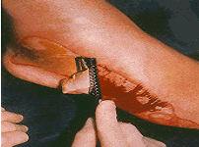
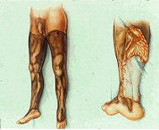
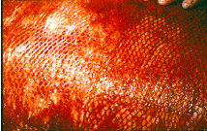
BURNS
Burns
Surgery - Later
Early Surgery - Tangential excision & Grafting
3-5 days Post Burn
- (Jancekovic)
Late Surgery - Wait till separation of dead
from viable
Excise and Graft
Skin Grafting - Depends on the Burn
Plastic Surgery - Required for reconstruction

Slide 34
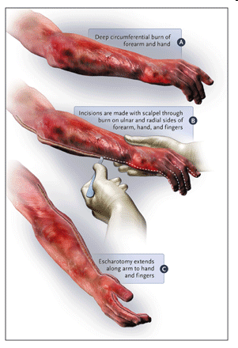
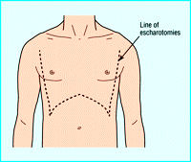
BURNS
Burns
Surgery - Immediate
Surgery for other injuries
Escharotomy

Slide 35

BURNS
Burns
Rehabilitation
Physical Rehabilitation
  Appearance
  Function
  Occupation
Mental Rehabilitation
  Prevent Suicide
  Accept changes
  Accept rejection
Why do People die from Burns ?
Immediately - Shock
Early - Infection & Sepsis
Late - Suicide

Slide 36
Burns
Special Issues - Burns in Children
- Non Accidental Injury
Injury pattern of non-accidental burns
• Obvious pattern from cigarettes, lighters, irons
• Burns to soles, palms, genitalia, buttocks, perineum
• Symmetrical burns of uniform depth
• No splash marks in a scald injury- A child falling into a bath will
splash
• Restraint injuries on upper limbs
• Is there sparing of flexion creases-that is, was child in fetal
position (position of protection) when burnt?
• Other signs of physical abuse—bruises of varied age, poorly
kempt, lack of compliance with health care (such as no
immunizations)

Slide 37
BURNS
Burns
Prevention of Burns
BURN IS APREVENTABLE INJURY
Risk factors of burns include
The presence of pre-existing impairments in children
Lapses in child supervision
Storage of flammable substances in the home
Low Maternal / Paternal education
Overcrowding
Use of Bottle lamps ( no access to electricity)
Lack of awareness / training in fire safety

